Slide 1
Maine Aeronautical Advisory Board
10-9-2019

Slide 2


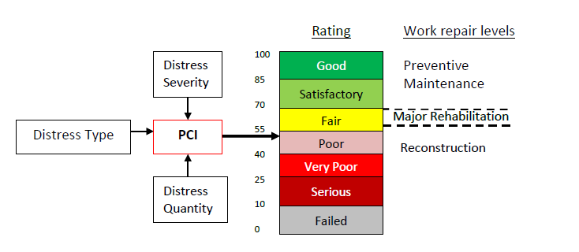

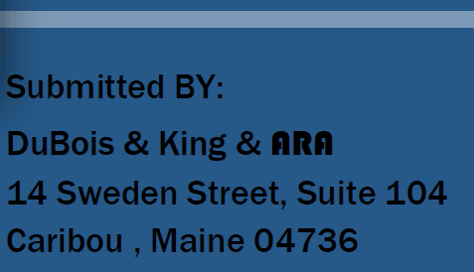

Slide 3
Process
Airport Pavement mapping –Branch, Section and Sample Unit creation
Field Measurements
PCI Determination
Database Creation
Report Creation
PAVER Training
Conclusions and Report Submission
    Airport Responsibilities

Slide 4
Branch Definitions
Runway
Taxiway
Taxilane
Apron
Sections
Uniform construction history
Typical Asphalt Concrete construction section size is 5,000 sq ft +/- 2,000 sq ft
Typical Portland Cement Concrete construction section size 20 slabs +/- 8 slabs
Sample Units
Number of sample units depends on the size of the branch

Slide 5
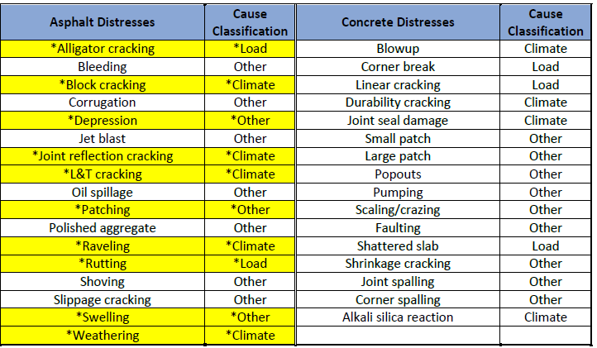
PCI Determination calculated by Distress Types, Severity and amounts

Slide 6
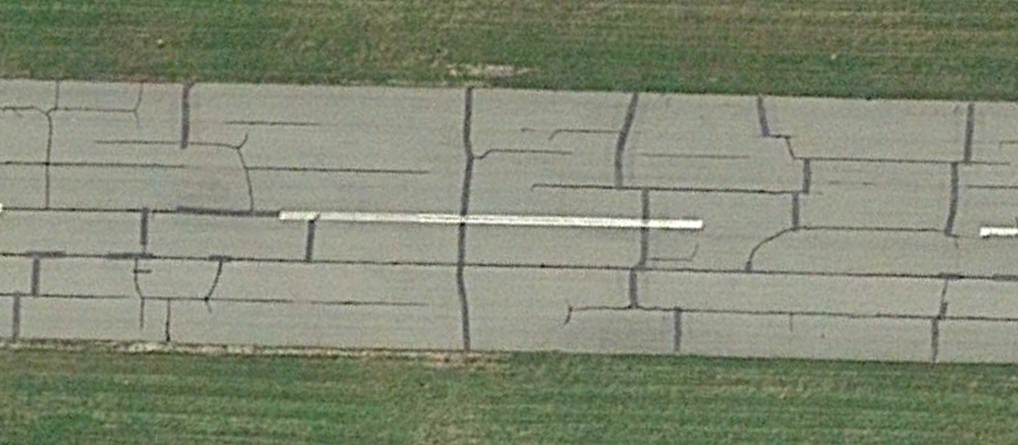
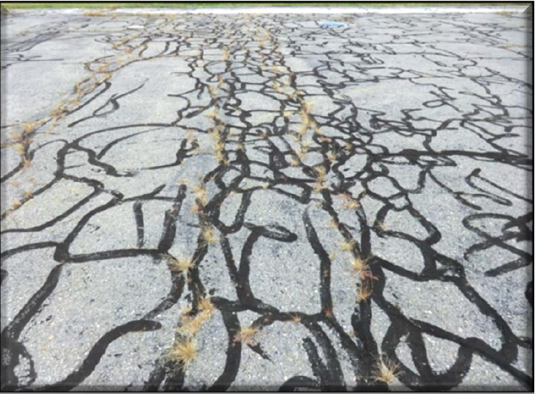

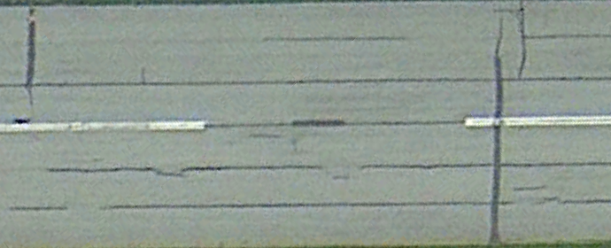
Sample Distresses

Slide 7
Pavement Condition Index Determination
MaineDOT has chosen a PCI rating of 70 as a trigger to schedule Rehabilitation or Reconstruction in your CIP

Slide 8
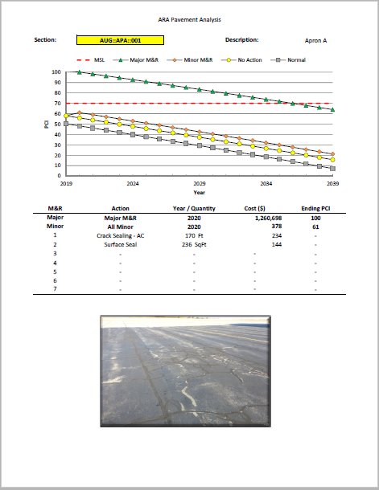
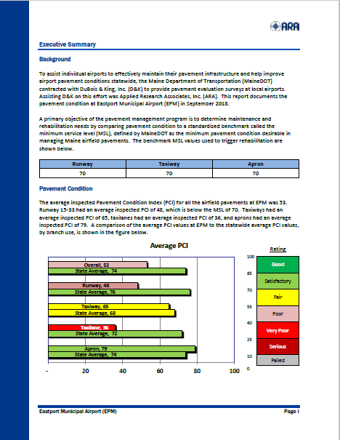
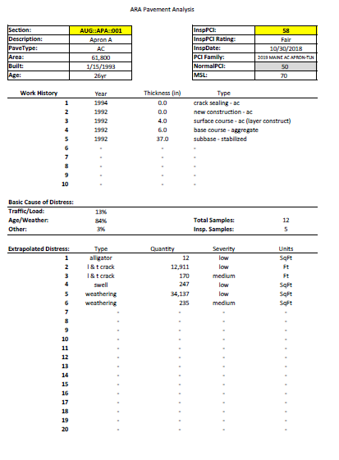
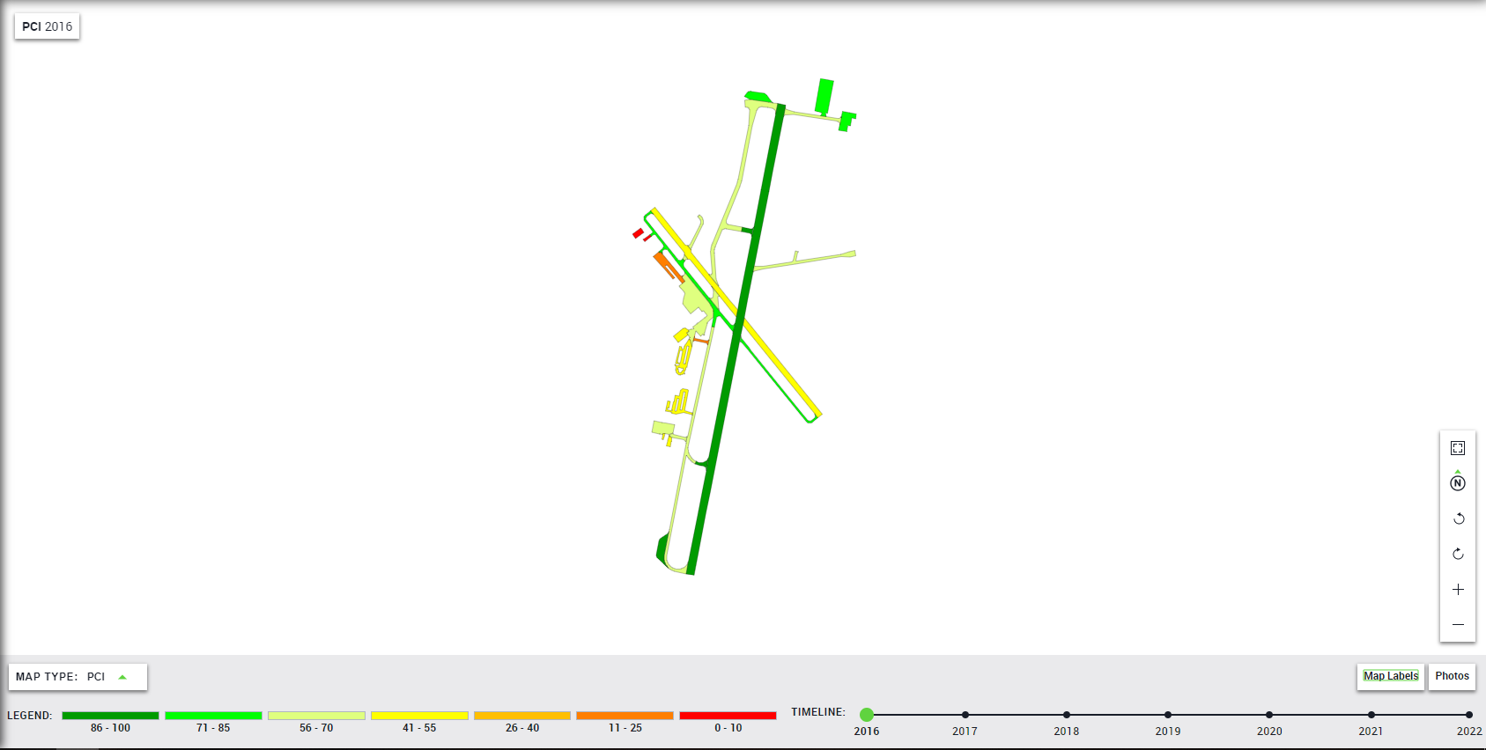
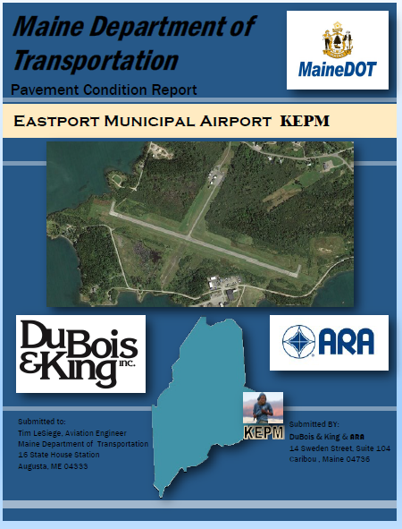

Slide 9
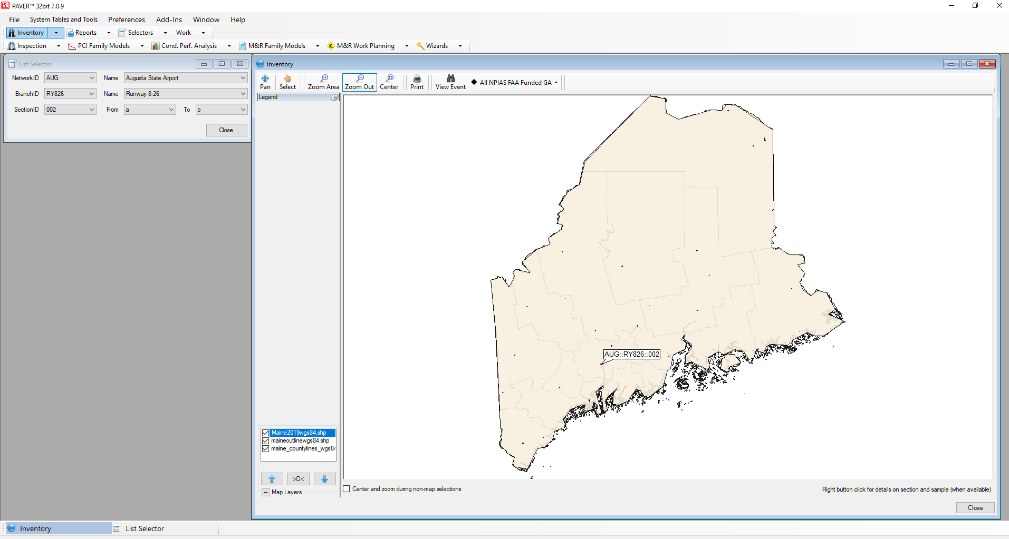
PAVER Training

Slide 10
Airport Responsibilities
The FAA has defined an acceptable maintenance-management program, and this report fulfills many
requirements of such a program, including documenting:
• Locations of all runways, taxiways, and aprons.
• Dimensions of the pavement system.
• Types of pavement.
• Year of construction or most recent major rehabilitation.
In accordance with best practices, the airport owner should be an active participant specifically by
implementing the following actions:
• Conduct a "drive-by" inspection at least monthly to detect changes in pavement condition.
• Record the date of each "drive-by" inspection and any maintenance performed as a result.
• Document all maintenance activities.
• Document detailed inspection information with a history of recorded pavement deterioration by
PCI survey (e.g., this report).
• Maintain all records on file for a minimum of 5 years.

Slide 11
Questions?

Slide 12
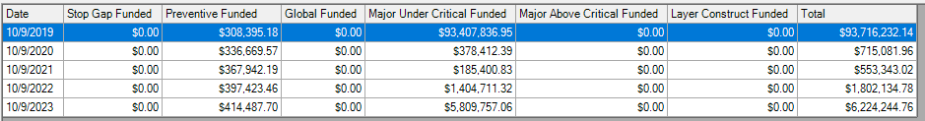
Costs to get (and keep) our airport pavements to at least a PCI of 70 using recommended maintenance based on 2018 calculated PCI
(Yes, we have a backlog of pavements that need attention)
(No, we don’t have $93,407,836.95 on hand to do this.)

Slide 13
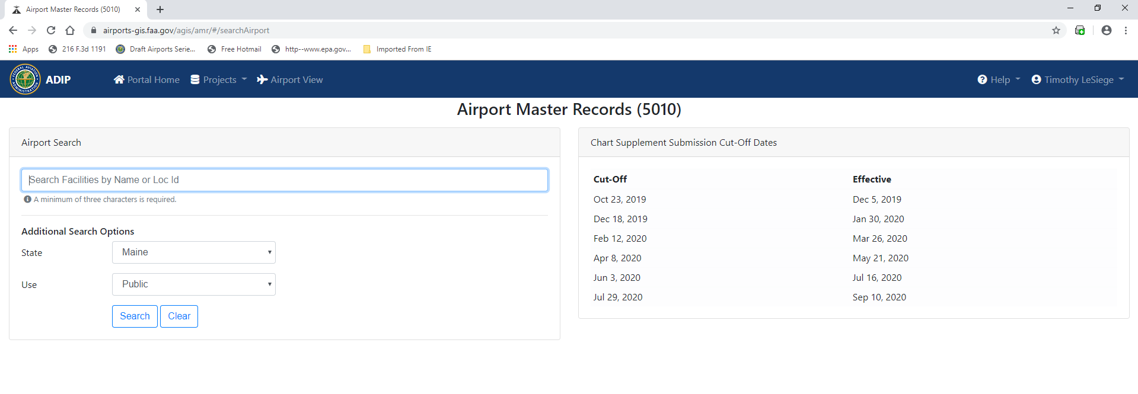
Airport Master Records – 5010 Data

Slide 14
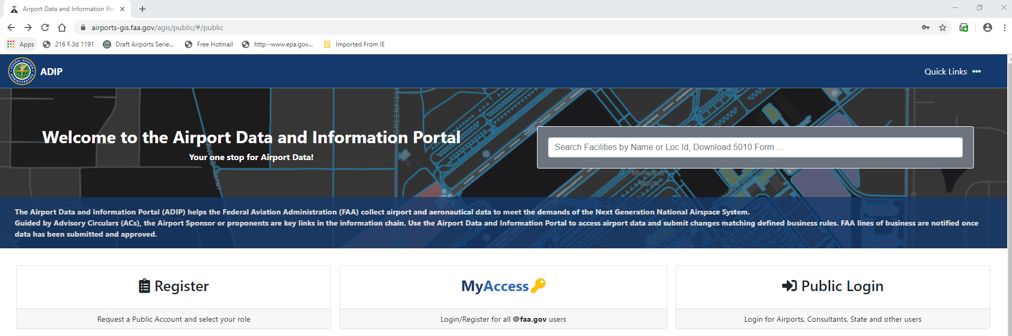
First and foremost – they’ve moved
  No Longer GCR website
  FAA website
    https://airports-gis.faa.gov/agis/public/#/public

Slide 15
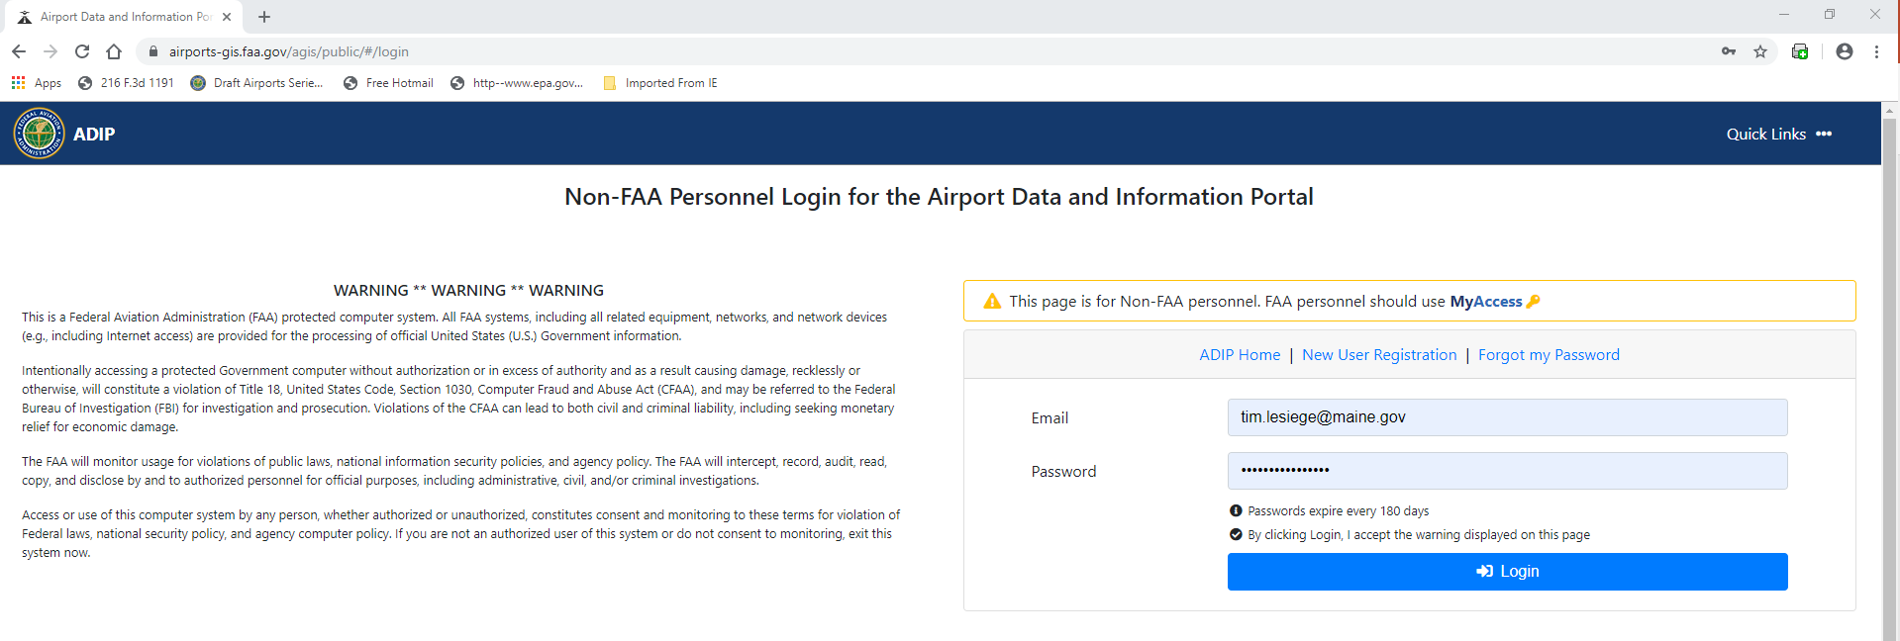
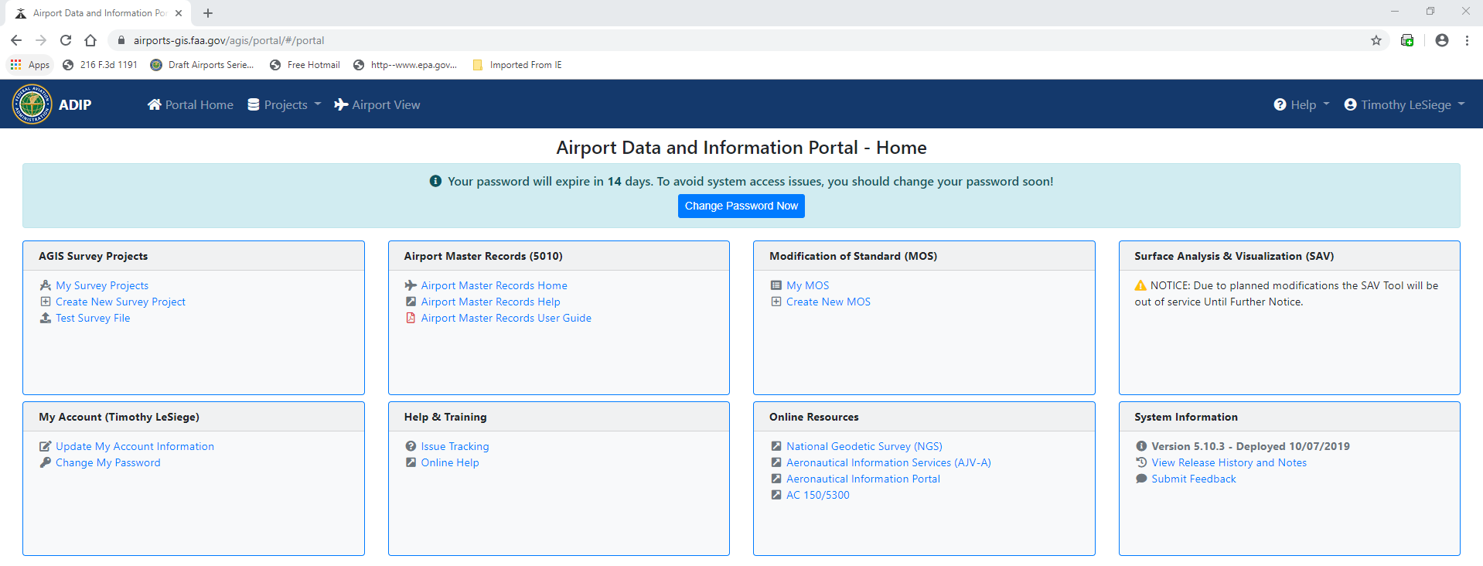

Slide 16
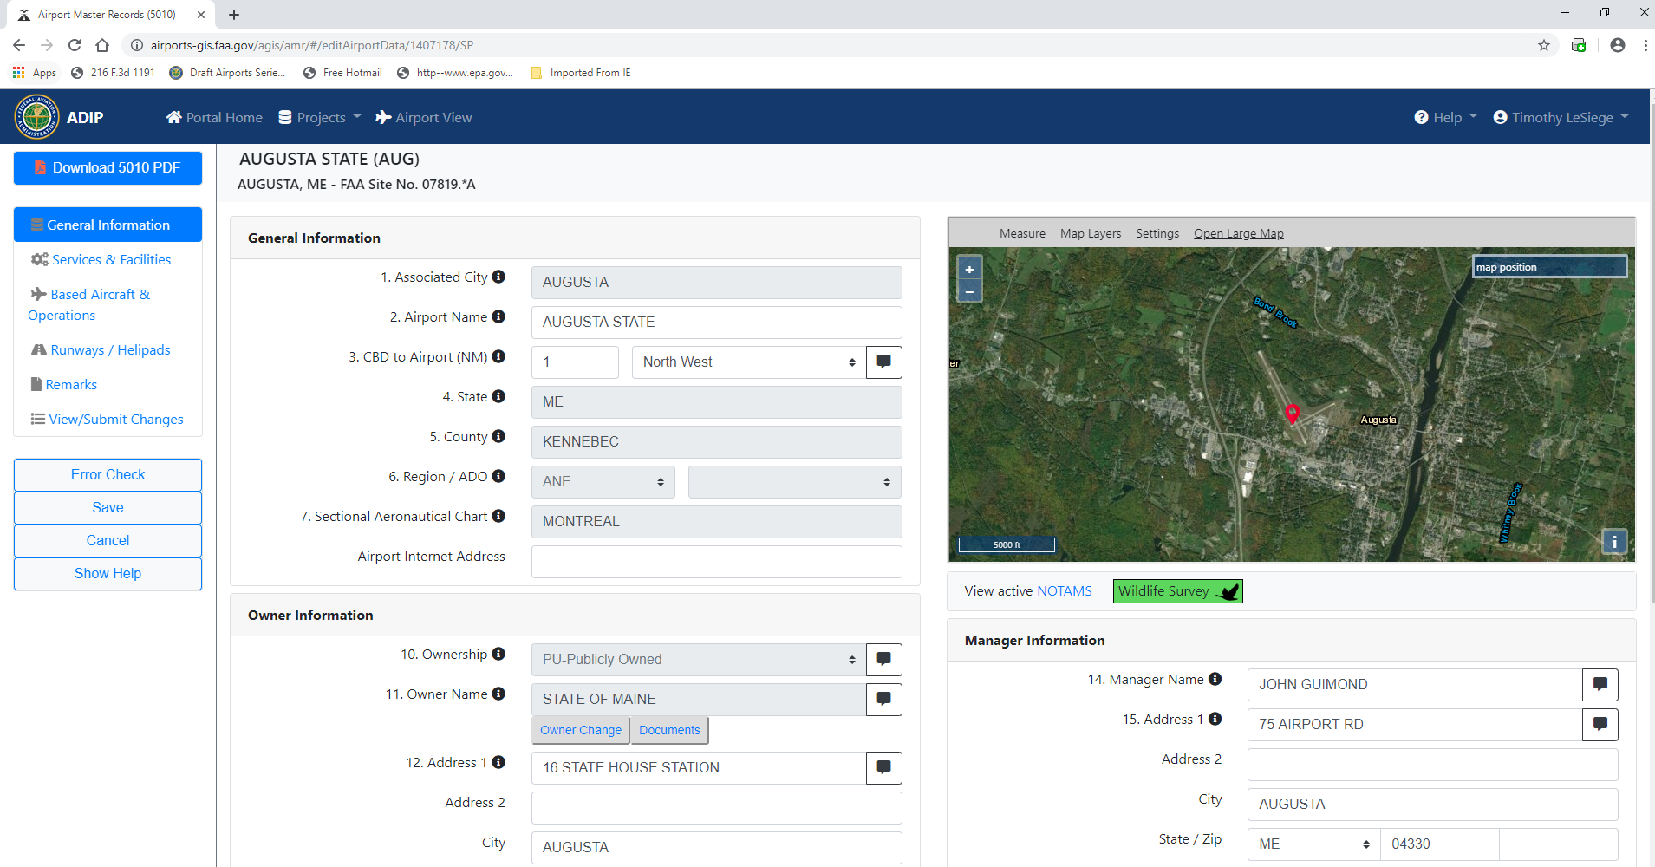
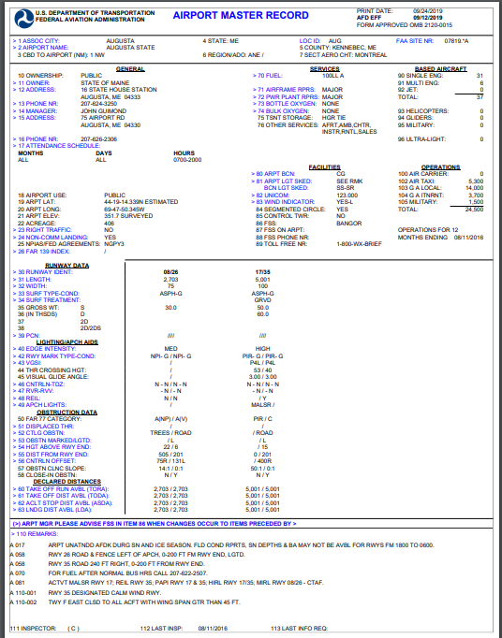
When you’ve logged in and want to print, the printed form looks exactly the same as it has in the past

Slide 17
Trends that need to be addressed
Reports from Jim Billdilli
  Is anyone reading these?
    Scheduling locally funded work based on these?
Close in Obstructions
  Within the first 200’ and as wide as primary surface
    Visual 250’ wide, NPI 500’ wide, PIR 1000’ wide
Approaches to be cleared?
  FAR PART 77 – as wide as primary surface at beginning point
  Engineering Brief 99 -Table 3-2
  TERPS – 400’ wide at beginning point
Regular Maintenance
Crackseal
Paint
Windsock
Segmented Circle

